Slide 1
ALEGRA results for blast problem starting from energized cylindrical core (“pill”)
Settings:
Domain dimensions = 2.2 m × 2.2 m
Domain origin: (0,0)
Element count = 256 × 256
Ideal gas with γ = 5/3 and C_{v} = 1.0 J/kg-K
Uniform initial density = 1.0 kg/m³
Exterior pressure = 0.1 Pa
Exterior temperature = 0.15 K
Core radius = 0.1 m
Core pressure = 10 Pa
Core specific internal energy = p/(ρ(γ-1)) = 15 J/kg
Core temperature = e/Cv = 15 K
Artificial viscosity (3 cases):
Default Q, with quadratic coefficient = 2.0 (recommended value)
Default Q, with quadratic coefficient = 0.1
“Modern Q” (Ed Love): hyperviscosity, Laplacian limiter, on in expansion, quadratic coeff = linear coeff = 1.0. Mipoint time integr.
Hyperbolic tangent profile on core e, p, T, with δ = 0.01 m:
$$T\left(x,y\right)=T_{core}+\frac{1}{2}\left(T_{core}−T_{ref}\right)\left(1+\tanh{{[(R}_{core}−r(x,y))/δ]}\right)$$

Slide 2
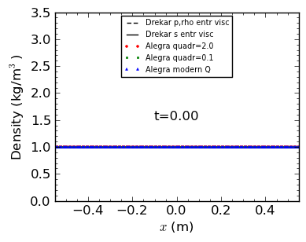
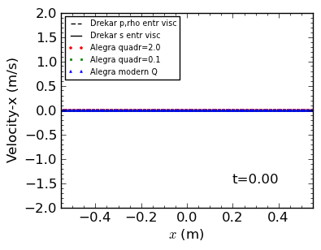
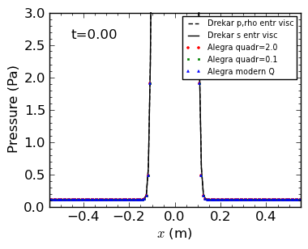
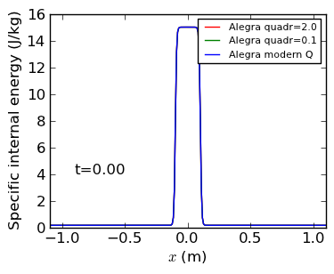

Slide 3
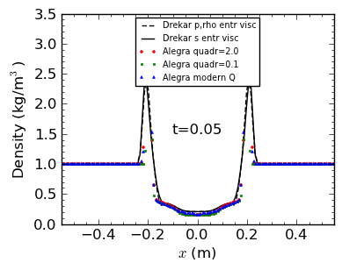
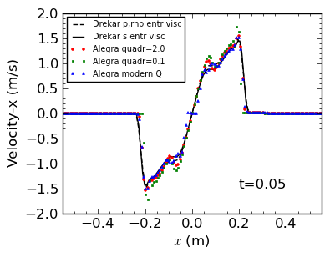
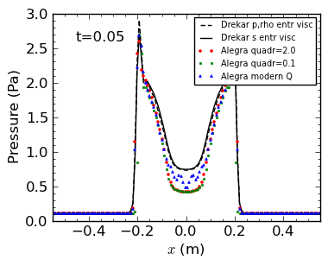
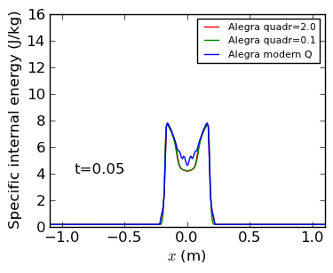

Slide 4
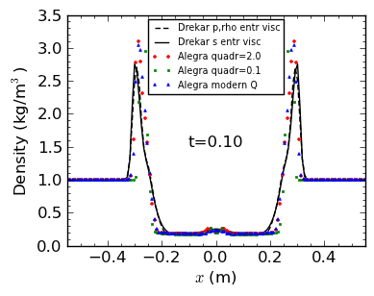
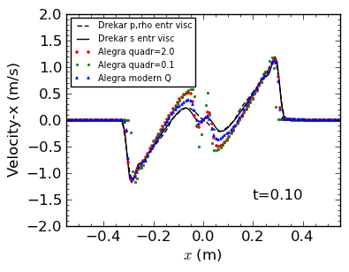
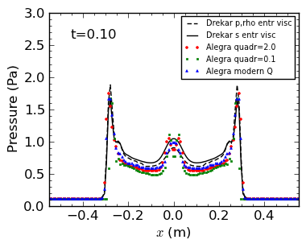
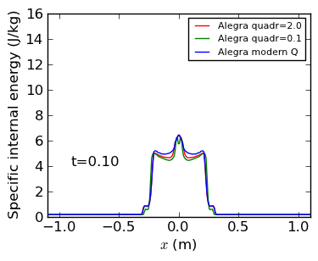

Slide 5
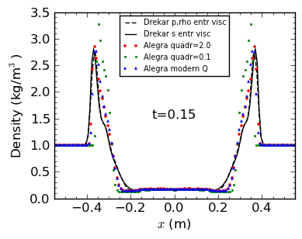
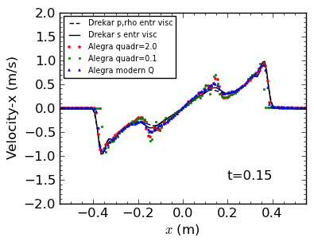
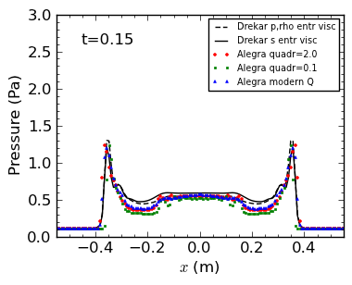
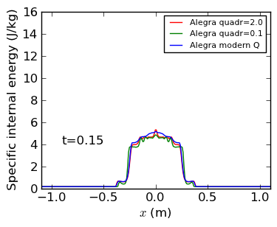

Slide 6
